Slide 1
Assignment 7 Root Locus
Nusair Islam

Slide 2
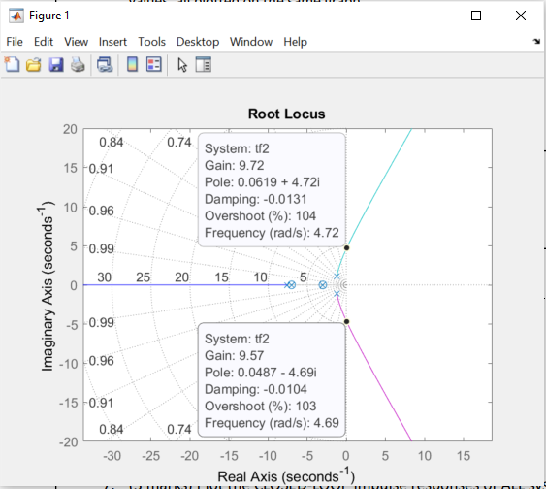
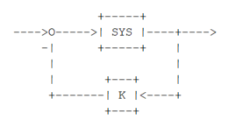
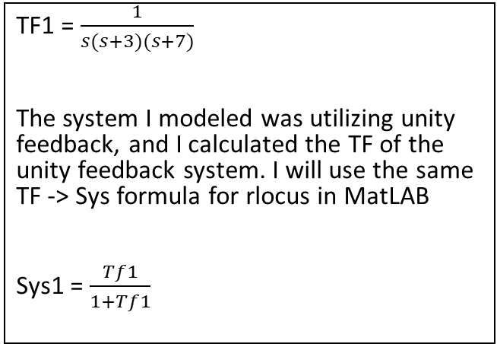
1
TF1 = $\frac{1}{s(s+3)(s+7)}$
The system I modeled was utilizing unity feedback, and I calculated the TF of the unity feedback system. I will use the same TF -> Sys formula for rlocus in MatLAB
Sys1 = $\frac{Tf1}{1+Tf1}$
You can see gain the two points I used to find gain is pretty close, I will say Ku ~ 9.65

Slide 3
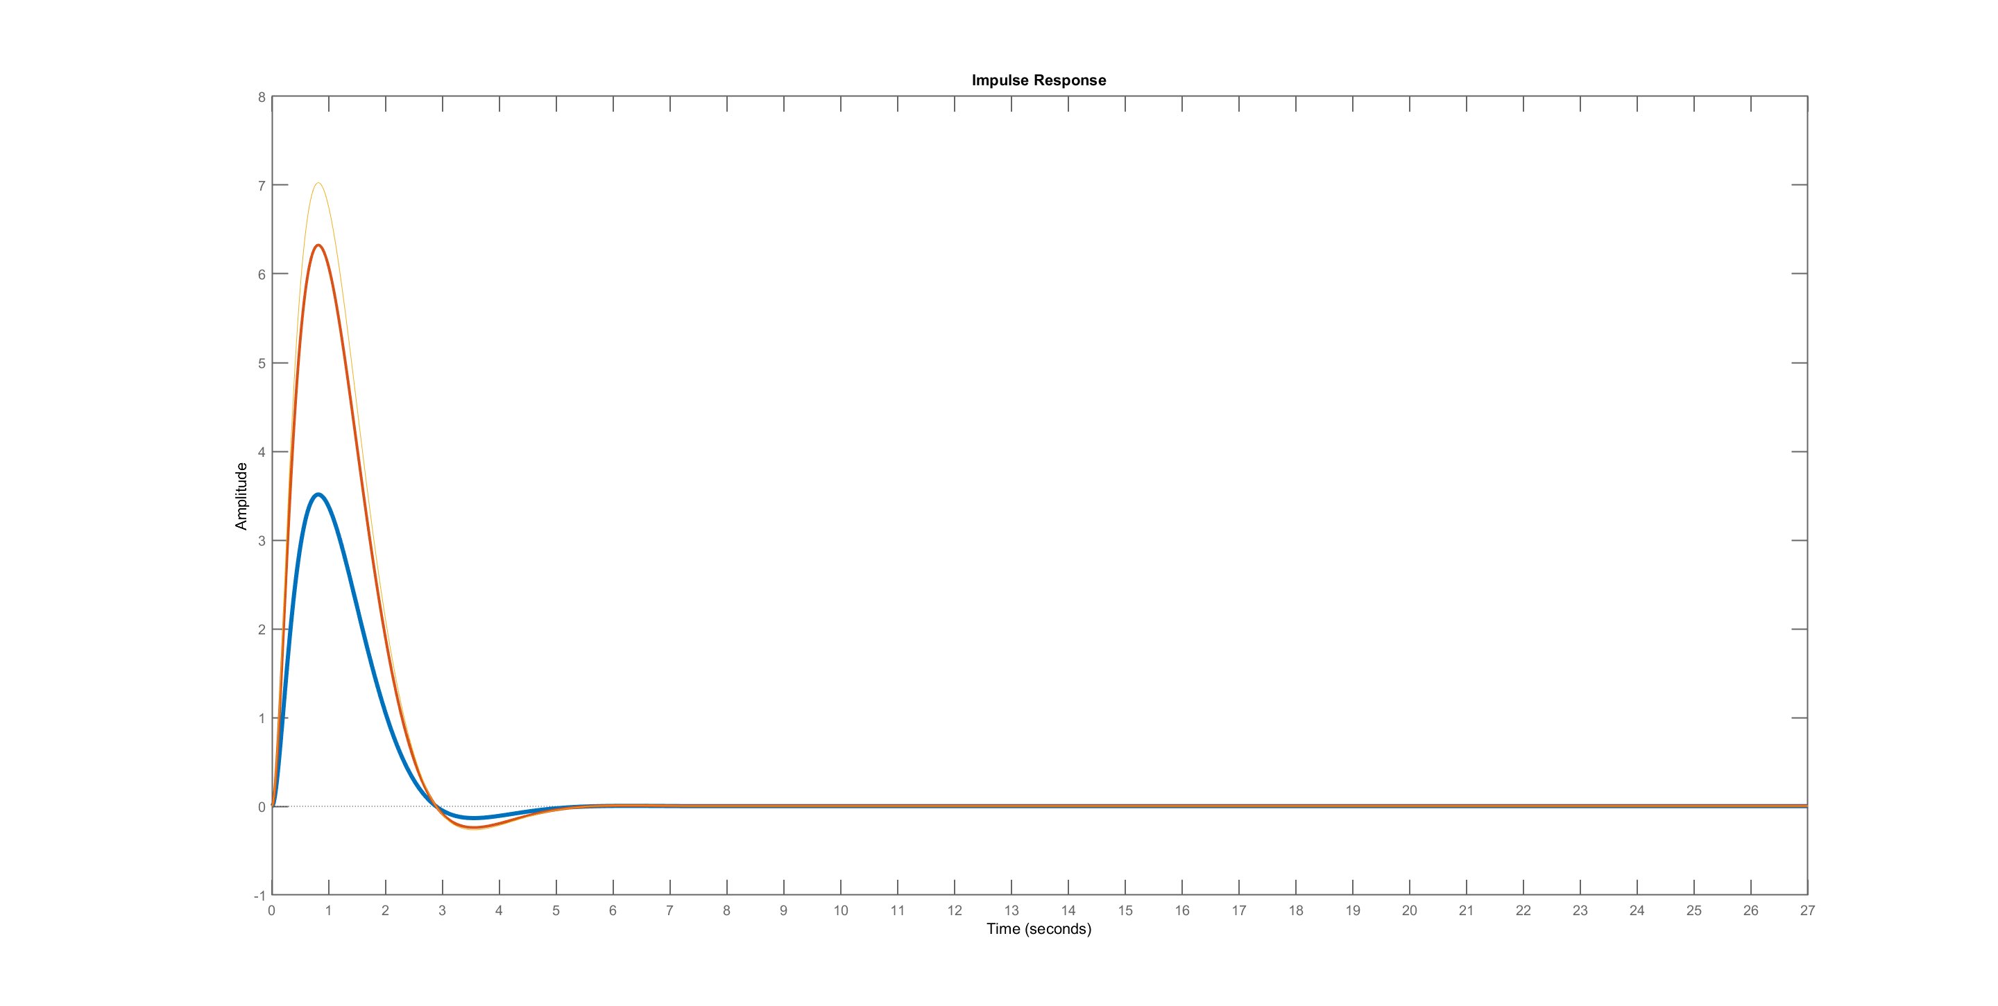
2

Slide 4
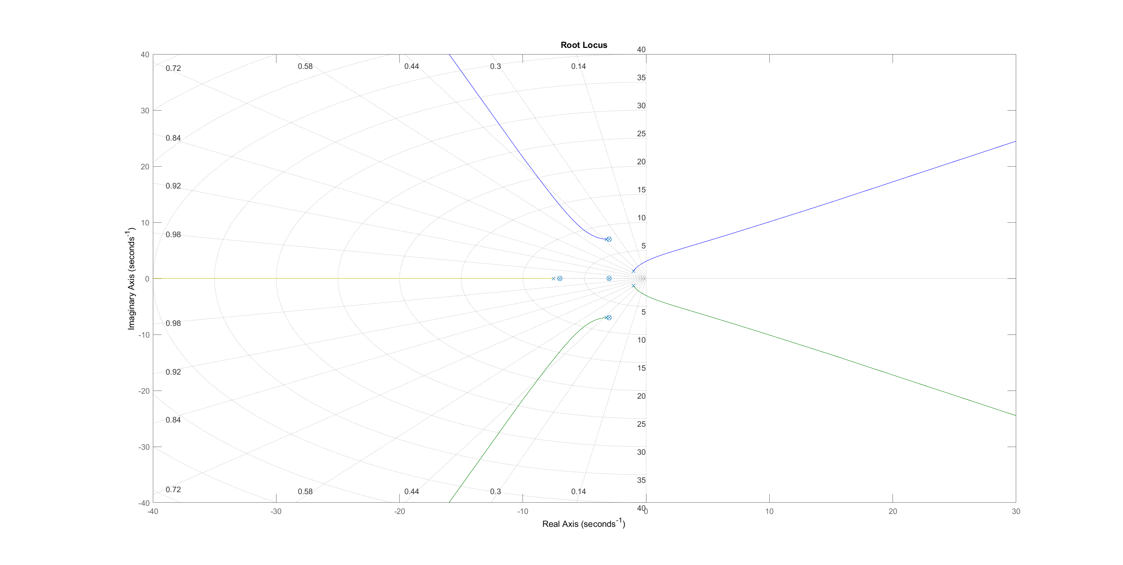
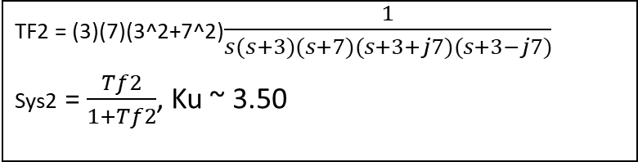
3
TF2 = (3)(7)(3^2+7^2)$\frac{1}{s(s+3)(s+7)(s+3+j7)(s+3−j7)}$
Sys2 = $\frac{Tf2}{1+Tf2}$, Ku ~ 3.50

Slide 5
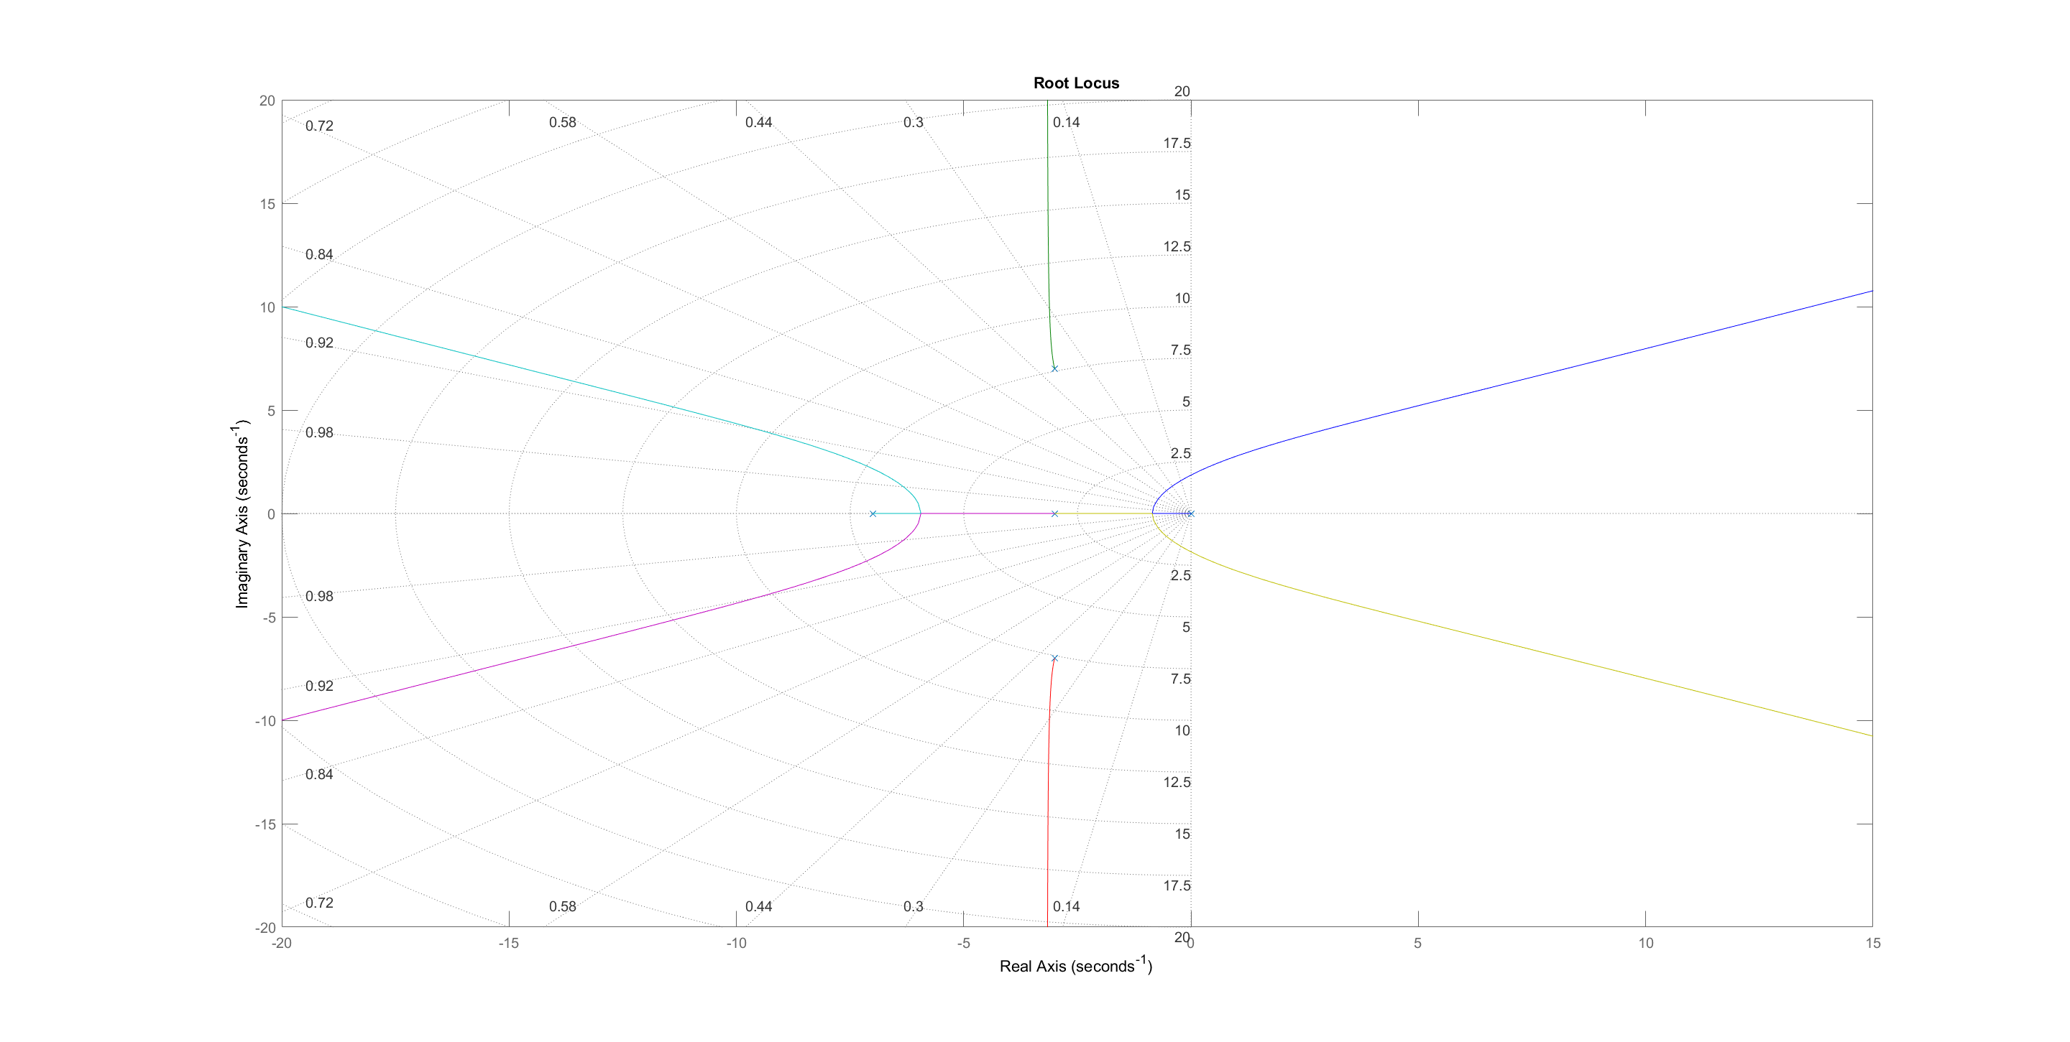
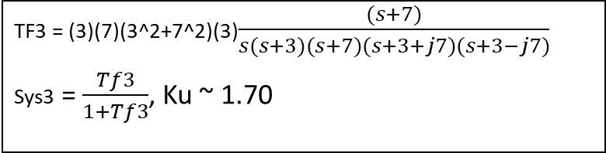
4
TF3 = (3)(7)(3^2+7^2)(3)$\frac{(s+7)}{s(s+3)(s+7)(s+3+j7)(s+3−j7)}$
Sys3 = $\frac{Tf3}{1+Tf3}$, Ku ~ 1.70

Slide 6
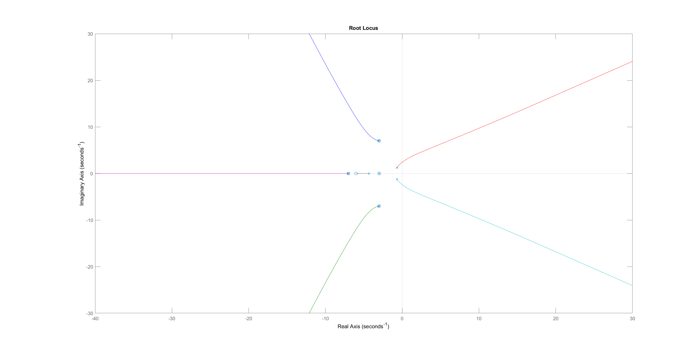
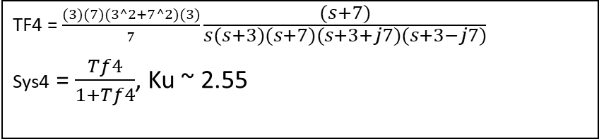
5
TF4 = $\frac{(3)(7)(3^2+7^2)(3)}{7}\frac{(s+7)}{s(s+3)(s+7)(s+3+j7)(s+3−j7)}$
Sys4 = $\frac{Tf4}{1+Tf4}$, Ku ~ 2.55

Slide 7
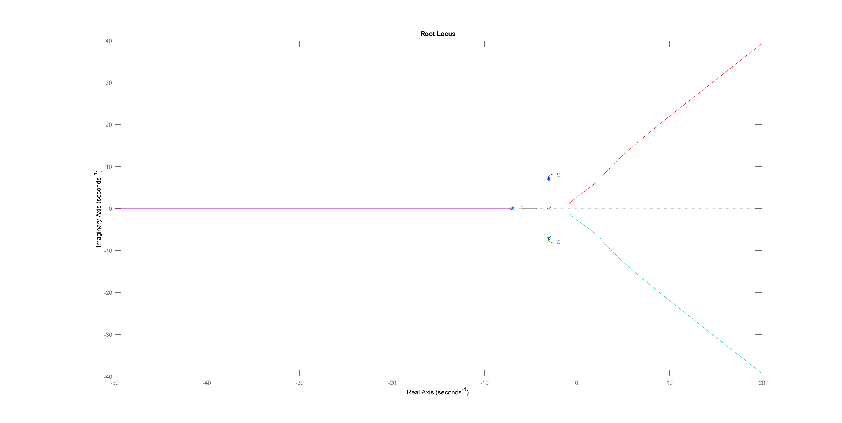
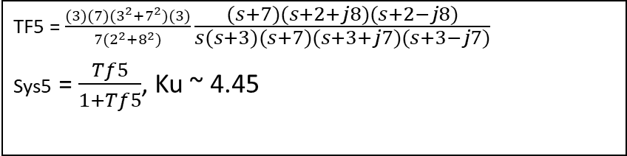
6
TF5 = $\frac{(3)(7)(3^{2}+7^{2})(3)}{7(2^{2}+8^{2})}\frac{(s+7)(s+2+j8)(s+2−j8)}{s(s+3)(s+7)(s+3+j7)(s+3−j7)}$
Sys5 = $\frac{Tf5}{1+Tf5}$, Ku ~ 4.45

Slide 8
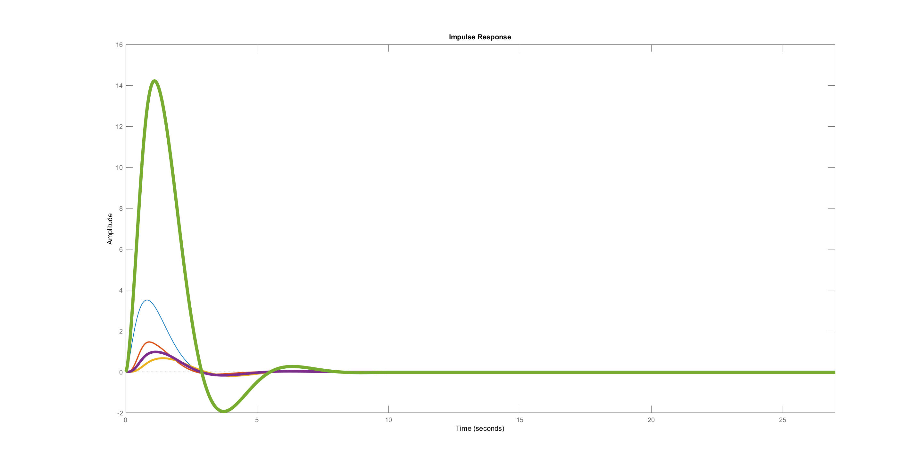
6
The width of the lines are sorted by the systems (system 1 has a width of 1, system 5 has a width of 5).
Adding a pole lowers the overshoot amount but adding a zero increased the overshoot amount by a lot. Especially, the last one, since we added a pair of complex zeroes
Stability depends on the application, but they all tend to the final value, although it seems like adding the zeroes takes longer to get to the final value

